Slide 1
Inter Module Diagram

Slide 2


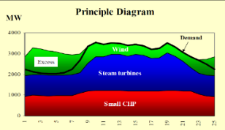
Energy Module - Overview
GHG Emissions
„What does this mean for our climate?“
Energy Emissions
Energy End-Use
„converting USD to kWh“
Fossil Fuel Demand
Economic demand
RES Potentials
„accounting for land competition and biophysical limits“
Industry (top-down)
HH-Buildings (Bottom-Up)
Transport (Bottom-Up)
PE Demand
Max. RES Capacity by Region
Endogeneous biophysical limitations
FE Demand
Energy Transformation
„modelling annual energy balances“
Limited Ressources
Transport Policy
Limited RES & vRES Potentials
Energy transformation
chain
Energy Intensities
Transformation Capacity
technology utilization
allocation
Energy Capacity
„accounting for capacity stocks“
Material- & land use
Exogenous Priorities
Dynamic OPEX*
Transformation technology capacities
Investment Demand
- vRES curtailment,
- P2Heat & Electrolyser utilisation
Heating systems (DSM),
Electr. Vehicles (Smart Charging, V2G?)
FE Demand
Generation Capacities
Transformation Technology Expansion allocation
Exogenous Priorities
Electrolyser, P2H & storage capacities
LCOE*
Expansion Priorities
LEGEND
Variability Management
„impact of intermittent power sources
on annual energy balances“
Main Output Variables
Emulation
EROI/ESOI
Estimate the Energy Return on Energy Invested of the System
Indicators
Main input Variables
Scenario Assumption
*… unfinished feature, not sure if it makes it into this versions results
*… Not sure which links are implemented, which are not, and if they make it into the june version
Energy Module – simplified representation of most important interrelations; Source: D11.2 LOCOMOTION
Date: 17.5.23

Slide 3
Energy Module - Overview
EROI system feeeback*
GHG Emissions
„What does this mean for our climate?“
Energy Emissions
Energy End-Use
„converting USD to kWh“
Fossil Fuel Demand
Economic demand
RES Potentials
„accounting for biophysical constraints and land competition“
Industry (hybrid*)
HH-Buildings (Top-down)
Transport (hybrid)
FE, PE
Max. RES Capacity by Region
Endogeneous biophysical limitations
FE Demand
Energy Transformation
„modelling annual energy balances“
Limited Ressources
Passenger transport Policy
Limited RES & vRES Potentials
Energy transformation
chain
Uranium availability
Energy Intensities
Transformation Capacity
technology utilization
allocation
Energy Capacity
„accounting for capacity stocks“
Material- & land use
Exogenous Priorities
Dynamic OPEX*
Transformation technology capacities
Investment Demand
- vRES curtailment,
- P2Heat & Electrolyser utilisation
Heating systems (DSM),
Electric Vehicles (Smart Charging, V2G)
FE Demand
Generation Capacities
Transformation Technology Expansion allocation
Exogenous Priorities
Electrolyser, P2H & storage capacities
Dynamic LCOE*
Expansion Priorities
LEGEND
Variability Management*
„impact of intermittent power sources
on annual energy balances“
Main Output Variables
Emulation
EROI/ESOI
Estimate the Energy Return on Energy Invested of the System
Indicators
Main input Variables
Scenario Assumption
Date: 19.7.2023WITH ANIMATION
*… unfinished feature, not sure if it makes it into this version results
Energy Module – simplified representation of most important interrelations; Source: D11.2 LOCOMOTION
Notes:
We saw overview before – this is what the energy module does.
END USE
Recives $ demand (by economic sector)
Convert to kWh demand (by FE-Fuel)
Mixed bottom-up top down
Bottom up: Transport, HH-buildings
Top down: industry (energy intensities)
Further work: selected industries also bottom-up
TRANSOFRMATION
Center-piece of energy module– calculates PE demand arising from FE demand.
Represents the whole energytransformation chain, and allocates the transformation technology usage („merit order“)
While accounting for all relevent influences
Capacity stock, energy variability & flexibility, etc.
CAPACITY
Accounting for stock and flow of transformation capacities
Taking into account biophysical limitations
Important hook-in point for policies
VARIABILITY
Accounts for impact of vRES on annual energy balances
Reaching 100% RES is NOT easy – it is very very hard
Requires significatn investment in flexibility technologies and overcapacities
And it‘s an effect often overlooked by annual IAMs
Methodological approach: emulating dispatch model results
100.000ds of dispatch model (EnergyPLAN) runs with different power system setups are analysed,
the resulting sub-annual timescale effects on annual energy balances emulated in WILIAM via regression analysis of results
EROI
Accounts for material and energy requirements of energy infrastructure

Slide 4
WILIAMs Energy Transformation Chain
Efficiencies
Efficiencies & Capacities
Efficiencies*
Transmission-, Storage- and FE- using Processes**
Refineration Processes
Transformation Processes
Allocation
Primary Energy (PE)
Transformation Input (TI)
Transformation Output (TO)
Final Energy (FE)
PE Consumption (to Materials- & Economic Module)
FE Demand (from end-use module)
+ Refineration losses
+ Transformation losses
+ Transmission & Storage Losses, -imports, +exports

Slide 5
WILIAMs Energy Transformation Chain
Variability Management
Efficiencies & Capacities
Transmission-, Storage- and Flexibility Processes
Transformation Processes
Refineration Processes
Allocation
FE Demand (from Enduse SM)
Final Energy (FE)
Transformation Input (TI)
Primary Energy (PE)
PE Demand (To GHG, Materials…)
Transformation Output (TO)
+ Transmission & Storage Losses, SEOC, electricity for PROSUP
+ Transformation losses
+ Refineration losses

Slide 6
Allocation priorities (OPEX, policy)
Allocation of heat to 15 CHP and HP technologies
Heat production from CHP & HP
Total heat demand
Heat production by technology
Electricity production
from CHP
Remaining electricity demand
Allocation of electricity to 20 PP technologies
Electricity production by technology
Total electricity demand
Allocation priorities (OPEX, policy)

Slide 7
Biophysical limiations
Capacity Expansion Priorities
Elec and heat demand
Overcapacity Factor
Allocation of heat shortfall
TO shortfall
Remaining elec shortfall
Biophysical limiations
Max. production from existing stock
Allocation of electricity shortfall
Capacity expansion Priorities
new CHP & HP
new PP
New Capacity
PROTRA capacity stock
Decomissioning

Slide 8
Supporting Diagrams

Slide 9
Important Prefixes in the Energy Module
NRG_ → Subscripts relating to Energy-module
FC_ → Final Consumption (=Final energy + non-energy consumption)
TO_ → Transformation Output
TI_ → Transformation Input
PE_ → Primary Energy
PROSUP_ → SUPply PROcesses
PROTRA_ → TRAnsformation PROcesses
PROREF_ → REFinery PROcesses

Slide 10





Energy Module
FE Imports/Exports
Emissions
PE demand
Energy End-Use
„converting USD to kWh“
Dynamic OPEX
RES Potential
„accounting for land competition“
Biophysical Limitations
Energy Transformation
„modelling annual energy balances“
Economic Demand
Max. Biofuel Production
Industry (top-down)
HH-Buildings (Bottom-Up)
Transport (Bottom-Up)
Final Consumption
Max. RES Capacity by Region
Energy transformation
chain
Energy Capacity
„accounting for capacity stocks“
Material- & Land Use
technology utilization
allocation
Available transformation Capacity
Transformation capacity – Stock- and flow modelling
vRES production with curtailment
Storage Losses
Flexible Production Tech. Utilization
Fossil PP utilization?!
Investments
Max. vRES production without curtailment
Transformation Technology Expansion allocation
DSM
Smart Charging
V2G
Energy Variability Management
„impact of intermittent power sources
on annual energy balances“
EROI/ESOI
Estimate the Energy Return on Energy Invested of the System
Policy
Assumptions
Date: 2.2.22
Energy Module – simplified representation of most important interrelations; Source: AEA

Slide 11
FE Imports/Exports
Emissions
PE demand
Energy End-Use
„converting USD to kWh“
Dynamic OPEX
RES Potential
„accounting for land competition“
Biophysical Limitations
Energy Transformation
„modelling annual energy balances“
Economic Demand
$
Final Consum-ption
Available transformation Capacity
Industry (top-down)
HH-Buildings (Bottom-Up)
Transport (Bottom-Up)
Energy transformation
chain
Energy Capacity
„accounting for capacity stocks“
Material- & Land Use
technology utilization
allocation
Transformation capacity – Stock- and flow modelling
Investments
Transformation Technology Expansion allocation
Flexibilities
Energy Variability Management
„impact of intermittent power sources
on annual energy balances“
EROI/ESOI
Estimate the Energy Return on Energy Invested of the System
Policy
Simplified version M30 report (1.3.22)
Energy Module – simplified representation of most important interrelations; Source: AEA
Notes:
Key elements:
tech utilization allocation
Capacity expansion allocation

Slide 12
Energy Variability Management sub-module
Max vRES CF
regressions
Max RES CF after curtailment
Max RES full load hours after curtailment
Max. RES elec after Curtailment
Transformation &
capacity sub-module
Capacity expansion allocation
Technology utilization allocation
Priorities (policy)
Priorities (Cost, policy..)
…requried new capacities to fulfill FE demand in t+1…
…required Primary Energy to fulfill FE demand in t…

Slide 13
WILIAMs Energy Transformation Chain
Physical Flow of Energy
Primary Energy (PE)
Transformation Input (TI)
Transformation Output (TO)
Final Consumption (FC)
Domestic Production, PE Imports/Exports
Refineration
Transformation
Transmission & Storage Losses, FE Imports/Exports
To Energy End Use
Calculation Flow (Demand-Driven)
Primary Energy (PE)
Transformation Input (TI)
Transformation Output (TO)
Final Consumption (FE)
PE Consumption (to Materials- & Economic Module)
FE Demand (from end-use module)
+ Refineration losses
+ Transformation losses
+ Transmission & Storage Losses, FE Imports/Exports + Flex. Demand

Slide 14
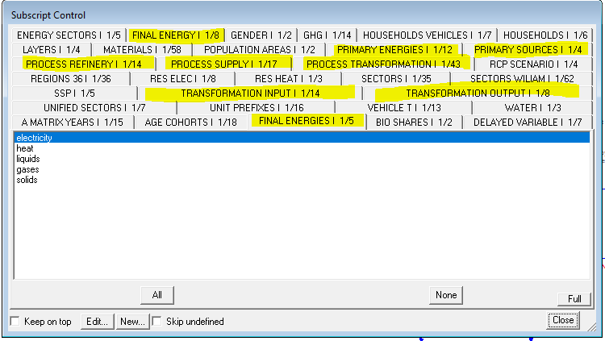
WILIAMs Energy Subscripts
Needs adaptation (names changed, number of TO, FC)
PROCESS_REFINERY_I
(PRCREF, 14)
PROCESS_TRANSFORMATION_I (PRCTRA, 43)
PROCESS_SUPPLY_I (PRCSUP, 17)
Disaggregation
Aggregation
PRIMARY_SOURCES_I
(4 Elements)
PRIMARY_ENERGIES_I (PE_, 12)
TRANSFORMATION_INPUT_I (TI_, 14)
TRANSFORMATION_OUTPUT_I (TO_, 8)
FINAL_ENERGY_I (FE_, 8)
FINAL_ENERGIES_I(5 Elements + H2)
Subscript from
MEDEAS
+Refineration
losses
+Transformation
losses
+Transmission & Storage Losses
Subscript from
MEDEAS

Slide 15
WILIAMs Energy Transformation Chain
Efficiencies
Efficiencies & Capacities
Efficiencies*
Transmission-, Storage- and FE- using Processes**
Refineration Processes
Transformation Processes
Allocation
Primary Energy (PE)
Transformation Input (TI)
Transformation Output (TO)
Final Energy (FE)
PE Consumption (to Materials- & Economic Module)
FE Demand (from end-use module)
+ Refineration losses
+ Transformation losses
+ Transmission & Storage Losses, -imports, +exports

Slide 16
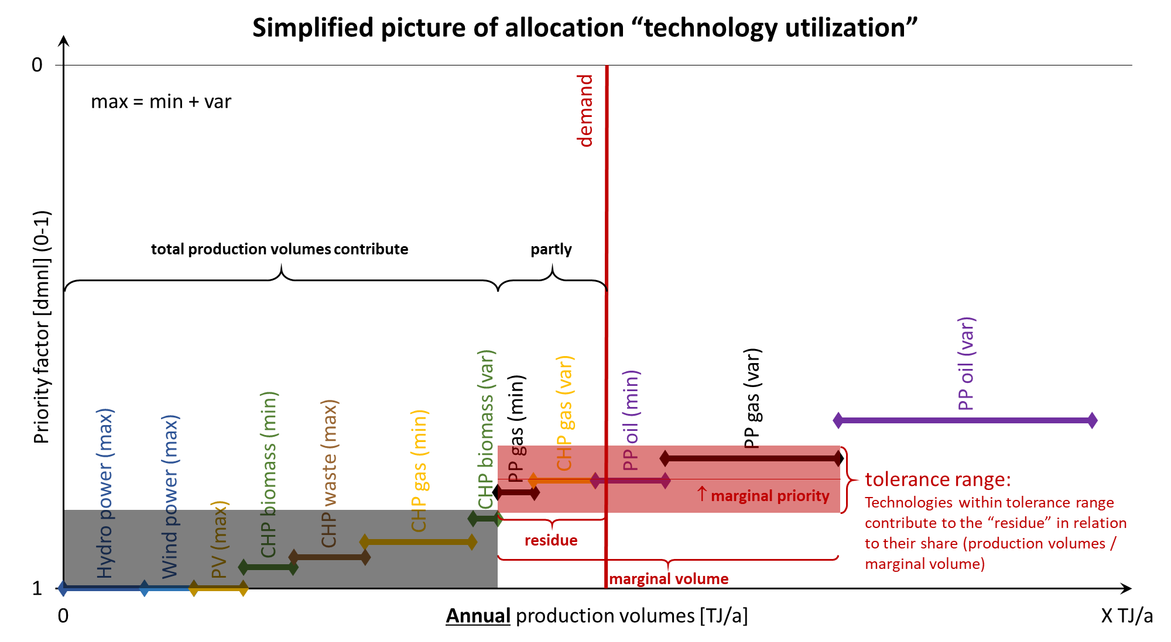
Allocation functions in energy module

Slide 17
Modelling Week
Feb_22 – day 1 – Energy Module Status

Slide 18
Energy module. End-use submodule
Formación interna
Valladolid. 19th July 2023
Ignacio de Blas/David Álvarez(Uva)

Slide 19
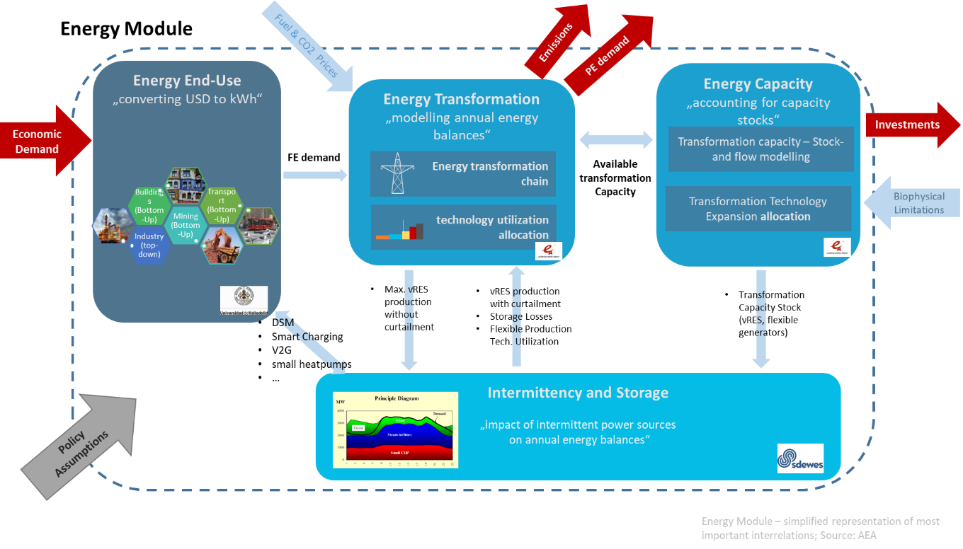
Introduction

Slide 20
Introduction
The final objective of this module is the estimation of the final energy demand.
The robust estimation of future energy demand is a key factor for the development of effective alternative policies.
The estimation of future energy demand is very complex and subject to uncertainties, depending on a diversity of factors: technological evolution, socio-cultural behavior, energy affordability, techno-sustainable potentials of energy resources, policies to be enforced, etc.

Slide 21
Introduction
Two main approaches are used in the literature for the estimation of future energy demand:
Top-down modelling approach: normally cover the energy system in a similar way for all sectors. In these models, energy demand and its changes over time depend on historical trends in economic variables and statistical issues for overall technology improvements.
Bottom-up modelling approach: are based on individual end-use data and the specific characteristics of each sector component, making these models consider much more data. (e.g., passenger per km, freight per km; m2 of buildings, etc.)
TOP-DOWN
BOTTOM-UP

Slide 22
Introduction
Each method presents different pros and cons and are more suitable depending on the scope and aims of the overall modelling framework.
The bottom-up approach is more precise and allows to test more specific policies, but at a cost of system consistency and the loss of some effects such as the rebound effect or leakage effects.
The top-down approach allows for a more complete analysis of the system at the cost of losing detail.
Modelling approach to energy demand in different IAMS
TOP-DOWN
BOTTOM-UP
MESSAGE
REMIND
WITCH
En-ROADS
GCAM
POLES-JCR
IMAGE-TIMER
AIM

Slide 23
Introduction
In different models also exists a certain level of hybridization between approaches.
WILIAM uses an hybrid approach between top-down and bottom-up.

Slide 24
WILIAM model

Slide 25

WILIAM model
WILIAM: 62 sectors (explained in economy session)
BOTTOM-UP approach
Transport sectors
Buildings
Energy sectors
Mining sectors*
TOP DOWN approach
Rest of sectors

Slide 26
WILIAM model
TOP-DOWN approach
Top-down approach is similar to the one carried out in MEDEAS and explained in (de Blas et al, 2019, https://doi.org/10.1016/j.esr.2019.100419).
This approach is based in energy intensity that stands as a relevant indicator of energy efficiency in the literature, having a clear and intuitive definition and straightforward computation in models. Energy intensity can be calculated as the ratio between energy consumption and economic output:
Energy consumption can be measured in different ways: primary energy, final energy or by disaggregating into different types of energy sources. Economic output can also be measured in different ways, with GDP being one of the most frequent.
$$Energy intensity=\frac{Energy consumption}{Economic output}$$

Slide 27
WILIAM model
TOP-DOWN approach
In WILIAM the sectoral final energy intensities are obtained dividing the sectoral final energy by the sectoral economic output for the all “Top-Down” sectors.
Historical data (2015) for both variables are obtained from EXIOBASE database: https://www.exiobase.eu/
Final energy demand of non “bottom-up” sectors are obtained multiplying the sectoral final energy intensities by sectoral output monetary demand.
TOP-DOWN APPROACH
Final energy intensity of non “bottom-up” sectors
ECONOMY MODULE
Output monetary non “bottom-up” sectors
Final energy demand of non “bottom-up” sectors

Slide 28
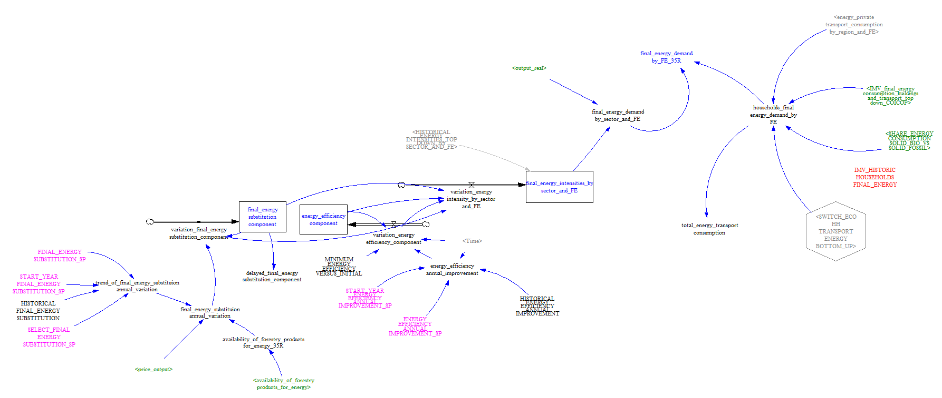
WILIAM model
The method is based on the top-down projection of the evolution of sectoral final energy intensities.

Slide 29
WILIAM model
David: davidalvarezantelo@gmail.com
BOTTOM UP approach: TRANSPORT submodule (passengers)
The total transportation demand is passed to the bottom-up transport module which computes, among other variables, the demand of public transportation by mode and the energy use for private transportation by fuel. These variables are then used by the economic module to compute the expenditure in fuel for private transportation and the expenditure in public transportation.
Private transportation by fuel
TRANSPORT BOTTOM-UP SUBMODULE
ECONOMY MODULE
Total transportation demand (million pkm)
Final energy demand of passengers transport
Public transportation by mode

Slide 30
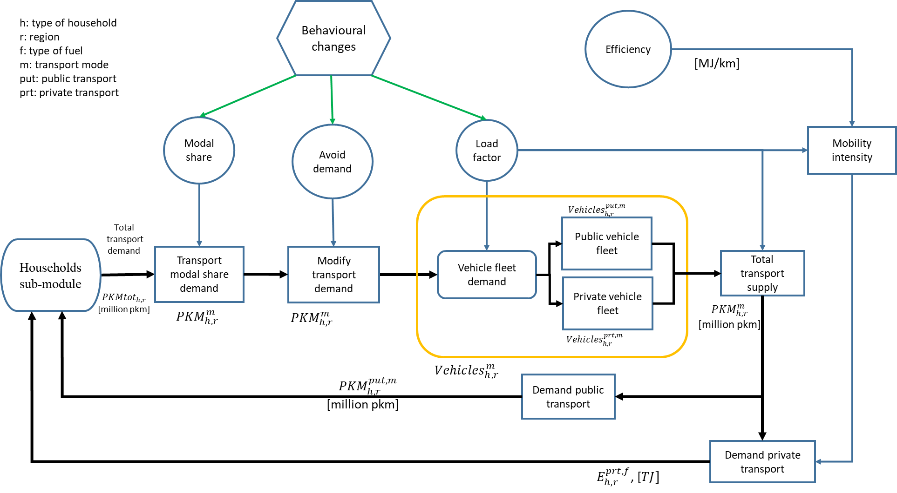
WILIAM model
BOTTOM UP approach: TRANSPORT submodule (passengers)

Slide 31
WILIAM model
BOTTOM UP approach: TRANSPORT submodule (passengers)
f: power train
m: transport mode
ICE: gasoline, diesel, gas, LPG
BEV: Battery Electric Vehicle
PHEV: Plug-in Hybrid Electric Vehicle
HEV: Hybrid Electric Vehicle
FCEV: Fuel Cell Electric Vehicle
HPV: Human Powered Vehicle
LDV: Light Duty Vehicles
BUS: Bus
MOTORCYCLES: Motorcycles 2Wheel and 3Wheel
RAIL: Rail
AIR: Air MARINE: Marine
NMT: Non Motorized Transportation

Slide 32
WILIAM model
BOTTOM UP approach: TRANSPORT submodule (passengers)
Shift to more sustainability transport
 | INITIAL (2025) |  |  | OBJECTIVE (2035)
 | LDV | BUS | 2W_3W | LDV | BUS | 2W_3W
ICE_gasoline | 12.60% | 0.02% | 2.94% | 6.3% | 0.08% | 2.94%
ICE_diesel | 40.13% | 5.96% | 0 | 20.06% | 23.84% | 0
ICE_LPG | 0.15% | 0.01% | 0 | 0.075% | 0.04% | 0
ICE_gas | 0.24% | 1.75% | 0 | 0.12% | 7% | 0
BEV | 0.01% | 0.02% | 0 | 0.005% | 0.08% | 0
PHEV | 0 | 0 | 0 | 0 | 0 | 0
HEV | 0 | 0 | 0 | 0 | 0 | 0
HPV |  |  | 0.053% |  |  | 2.72%

Slide 33
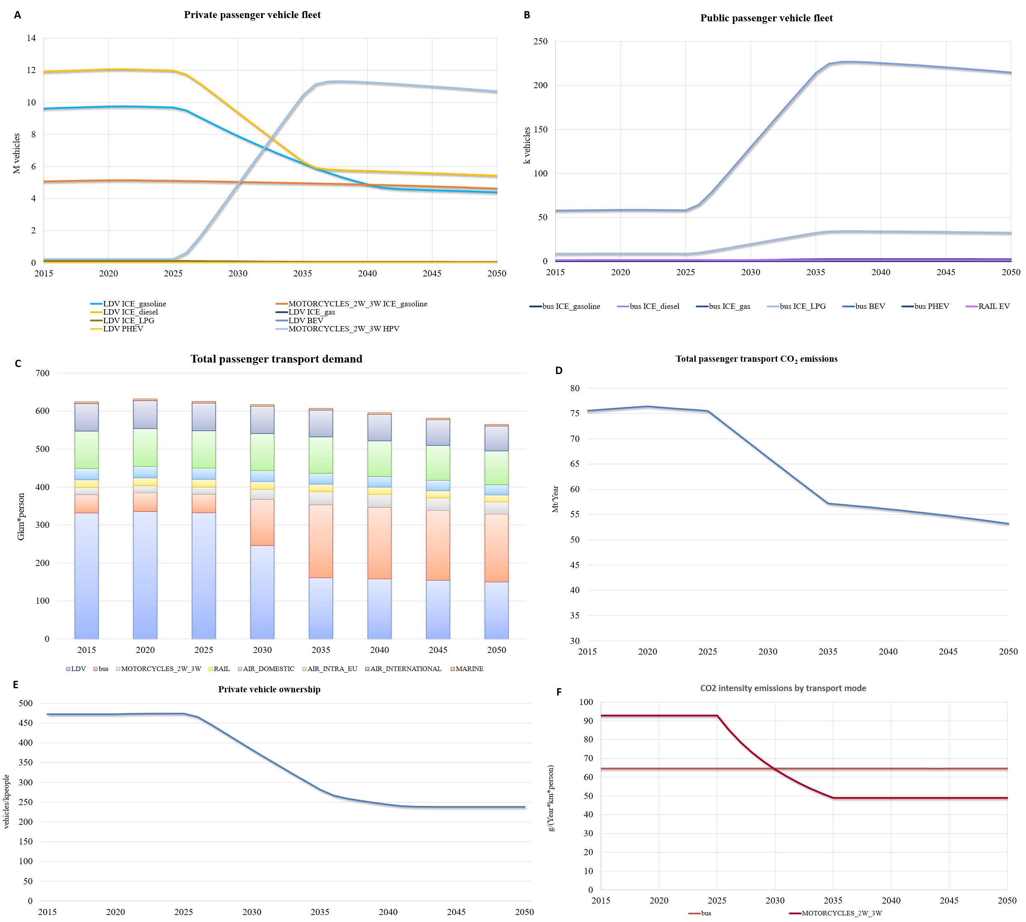
WILIAM model
BOTTOM UP approach: TRANSPORT submodule (passengers)

Slide 34
WILIAM model
BOTTOM UP approach: TRANSPORT submodule (passengers)

Slide 35
WILIAM model
BOTTOM UP approach: TRANSPORT submodule (freight)
This submodule is not yet implemented in WILIAM.
The general approach is to use transport intensities (tkm/Mio USD) to calculate the transport demand by model (in tkm).
As in households transport module, the transport module calculate energy demand which will be sent to the energy module and also to the economic module.
Transport module will also model the evolution of transport intensities.
47 | 49.1 + 49.2 | Transport via railways
48 | 49.3 + 49.4 | Other land transport
49 | 49.5 | Transport via pipelines
50 | 50.1 + 50.2 | Sea and coastal water transport
51 | 50.3 + 50.4 | Inland water transport
52 | 51 | Air transport

Slide 36
WILIAM model
Alexandros: aladam@cres.gr
BOTTOM UP approach: BUILDINGS
Implementation GAMS (not implemented yet in Vensim in WILIAM).
Regional classification: EU27 + UK , 2015 Base Year
DATA: Building Stock Data Collection (Eurostat, Odyssee, JRC) , GDP projections (AMECO- annual macro-economic database-2023), Population projections (Eurostat), Disaggregated final energy consumption in households (Eurostat, JRC). Stock of dwellings by type of SH technologies (Odyssee,JRC-IDES), Tech data (costs, efficiencies) – JRC,2017.
Household Stock Disaggregation Implementation
Single , Multi family
Urban, Rural - capture differences in population growth in urban-rural areas, urbanisation etc.
Construction period (7 age bands)
Share of dwellings built before 1945
Share of dwellings built between 1945 and 1969
Share of dwellings built between 1970 and 1979
Share of dwellings built between 1980 and 1989
Share of dwellings built between 1990 and 1999
Share of dwellings built between 2000 and 2010
Share of dwellings built after 2010

Slide 37
WILIAM model
BOTTOM UP approach: BUILDINGS
Useful and final energy
BOTTOM UP BUILDINGS SUBMODULE
ECONOMY MODULE
Comfort
Final energy buildings
Comfort = f (price_total_heating, Income)
level of service comfort [0-1]

Slide 38
WILIAM model
BOTTOM UP approach: BUILDINGS
$${Final_ene}_{r,h,f,u}={Comfort}_{r,h}×\left[{Useful_ene}_{r,h,u}×{sh_fuel}_{r,h,f,u}× \frac{1}{{efficiency}_{r,h,f,u}}×{NR_dwell}_{r,h}\right]×{∆HDD}^{m}$$
Final Energy_{r,h,u,f}
Economic module
(Households sub-module)
Final Energy_{𝒓,𝒉,𝒖_rest,𝒕𝒆𝒄𝒉}
Useful Energy_{𝒓,𝒉,𝒖_hc,𝒕𝒆𝒄𝒉}
$r$: region
$h$: household
$f$: fuel
Tech: technologies
u_hc: uses Space Heating, Water Heating, Space Cooling
u_rest: uses Cooking, Lighting, Appliances, Other end use
Comfort_{r,h}
Bottom up Household energy module
level of service comfort [0-1]
=f(price_total_heating, Income)
Retrofits, Technologies

Slide 39
WILIAM model
BOTTOM UP approach: BUILDINGS
Number of buildings
Retrofits/Technology Allocation
Weibull Distribution used to identify the probability of dwellings applying different retrofits or technology replacement
Takes into account lifetime cost of technology
Applied to each household class as different heating demand will affect choice
(+) New constructions depends on the projection of historical construction rate based on GDP
(-) Demolitions depend on Historical demolition rate by country

Slide 40
WILIAM model
WILIAM: 62 sectors (explained in economy session)
BOTTOM-UP approach
Transport sectors
Buildings
Energy sectors
Mining sectors*
TOP DOWN approach
Rest of sectors
Final energy demand of transport sectors
Final energy buildings
Energy self- consumption in energy sectors
Transformation inputs
Transformation outputs
Total final energy demand
Final energy demand of non “bottom-up” sectors

Slide 41
Energy variability (Gonzalo)
Input files of EnergyPLAN
Inputs of EnergyPLAN
(design of the experiment)
Installed capacity of wind onshore
Installed capacity of solar-PV
…
Combinations of inputs
(3^{n} ≈ 1.6 million)
3 values per input.
All with all without repetition.
EnergyPLAN
(hourly)
IAM
(yearly)
$$y\sim β_{0}+\sum_{i=1}^{k}{β_{i}∙x_{i}}$$
Parallel processing
(Python)
$$y\sim e^{−(β_{0}+\sum_{i=1}^{k}{β_{i}∙x_{i}})}$$
Output files of EnergyPLAN
Generation of wind onshore
Generation of solar-PV
…
List of equations
&
confidence intervals
Regression analysis
Preparing data
for regression analysis

Slide 42
The modelling in WILIAM:
Implementation of regression models, with one proxy per input.
View: energy-variability.regressions
Stock-flow structures for power-to-heat, electrolysers, and storage.
View: energy-variability.electrolyzer_H2_production_and
View: energy-utility_scale_storage.dedicated_capacities
View: energy-power2heat
Technological market to expand the flexibility options.
View: energy_variability.PROFLEX_allocation

Slide 43
RES (techno-sustainable) potentials
Theoretical
Geographical
Technical
Economic
Sustainable

Slide 44
RES (techno-sustainable) potentials
EXOGENOUS INITIALIZED
Estimated outside of the model (in EJ/year)
Can be modified endogenously during the simulation
2 types:
From GIS (wind onshore & offshore): different potentials depending on the EROImin criteria applying Dupont’s (2018) method
From literature review and own estimates (hydropower, PHS, solar rooftop, geothermal, oceanic and waste)
ENDOGENOUS (land-use dependent)
Solar PV on ground:
LUE (km2/MW) = f ( EROImin; geography; PV efficiencies)
Eventual limitation in capacity expantion
Biofuels and biogas:
Limitation in transformation input shares
Wood (ongoing task)
Dupont, E., Koppelaar, R., Jeanmart, H., 2018. Global available wind energy with physical and energy return on investment constraints. Applied Energy 209, 322–338. https://doi.org/10.1016/j.apenergy.2017.09.085

Slide 45
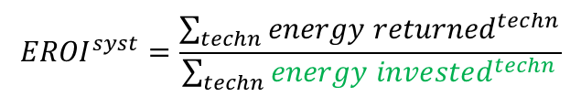
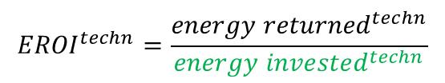
EROI/ESOI
Same methodology as in MEDEAS:
Literature review to collate the mineral intensities (kg/MW) of minerals for energy technologies
Novelties in WILIAM:
Subtechnologies of solar PV (Pulido 2022): rooftop vs ground; poly-Si, mono-Si, CIGS, CdTe.
Subtechnologies of electric batteries (Pulido et al 2022): LMO, NCA, NMC622, NMC811, LFP.
Key missed objectives in GA LOCOMOTION:
Computation of the EROI of all energy technologies
Feedback varaition of EROI of the system to economy module
$${Energy invested}^{New cap, i}\left(t\right)={Material intensity}_{i}^{j}\left[\frac{kg}{MW}\right]∙{Embodied energy for material use}^{j}[\frac{MJ}{kg}](t)$$
$${EROI}^{techn}=\frac{{energy returned}^{techn}}{{energy invested}^{techn}}$$
$${EROI}^{syst}=\frac{\sum_{techn}{{energy returned}^{techn}}}{\sum_{techn}{{energy invested}^{techn}}}$$
Pulido-Sánchez, D., Capellán-Pérez, I., Castro, C. de, Frechoso, F., 2022. Material and energy requirements of transport electrification. Energy Environ. Sci. 15, 4872–4910. https://doi.org/10.1039/D2EE00802E
Pulido-Sánchez, D., 2022. Requerimientos materiales y EROI de las tecnologías fotovoltaicas en la transición energética (Trabajo Fin de Máster). Universidad de Valladolid. https://uvadoc.uva.es/handle/10324/56539

Slide 46
Modelling Week
Feb_22 – day 2, Workshop „Energy-Materials-Economy-Land“

Slide 47
Topics
General Link: Energy-Economy → Ensuring consistency between monetary and physical flows
H2-fuels demand
FE Solid demand Split: Bio / Fossil
Allocation priorities in Tech-Utilization
Solid Biomass: Restrictions in available biomass as TI for PP and CHP
Material demand and Energy Intensities
Split of Landproducts to different uses
Investment cost (energy sectors)
Notes:
1h45min time
Talk 15min per topic
Write down discussion results directly in slides

Slide 48
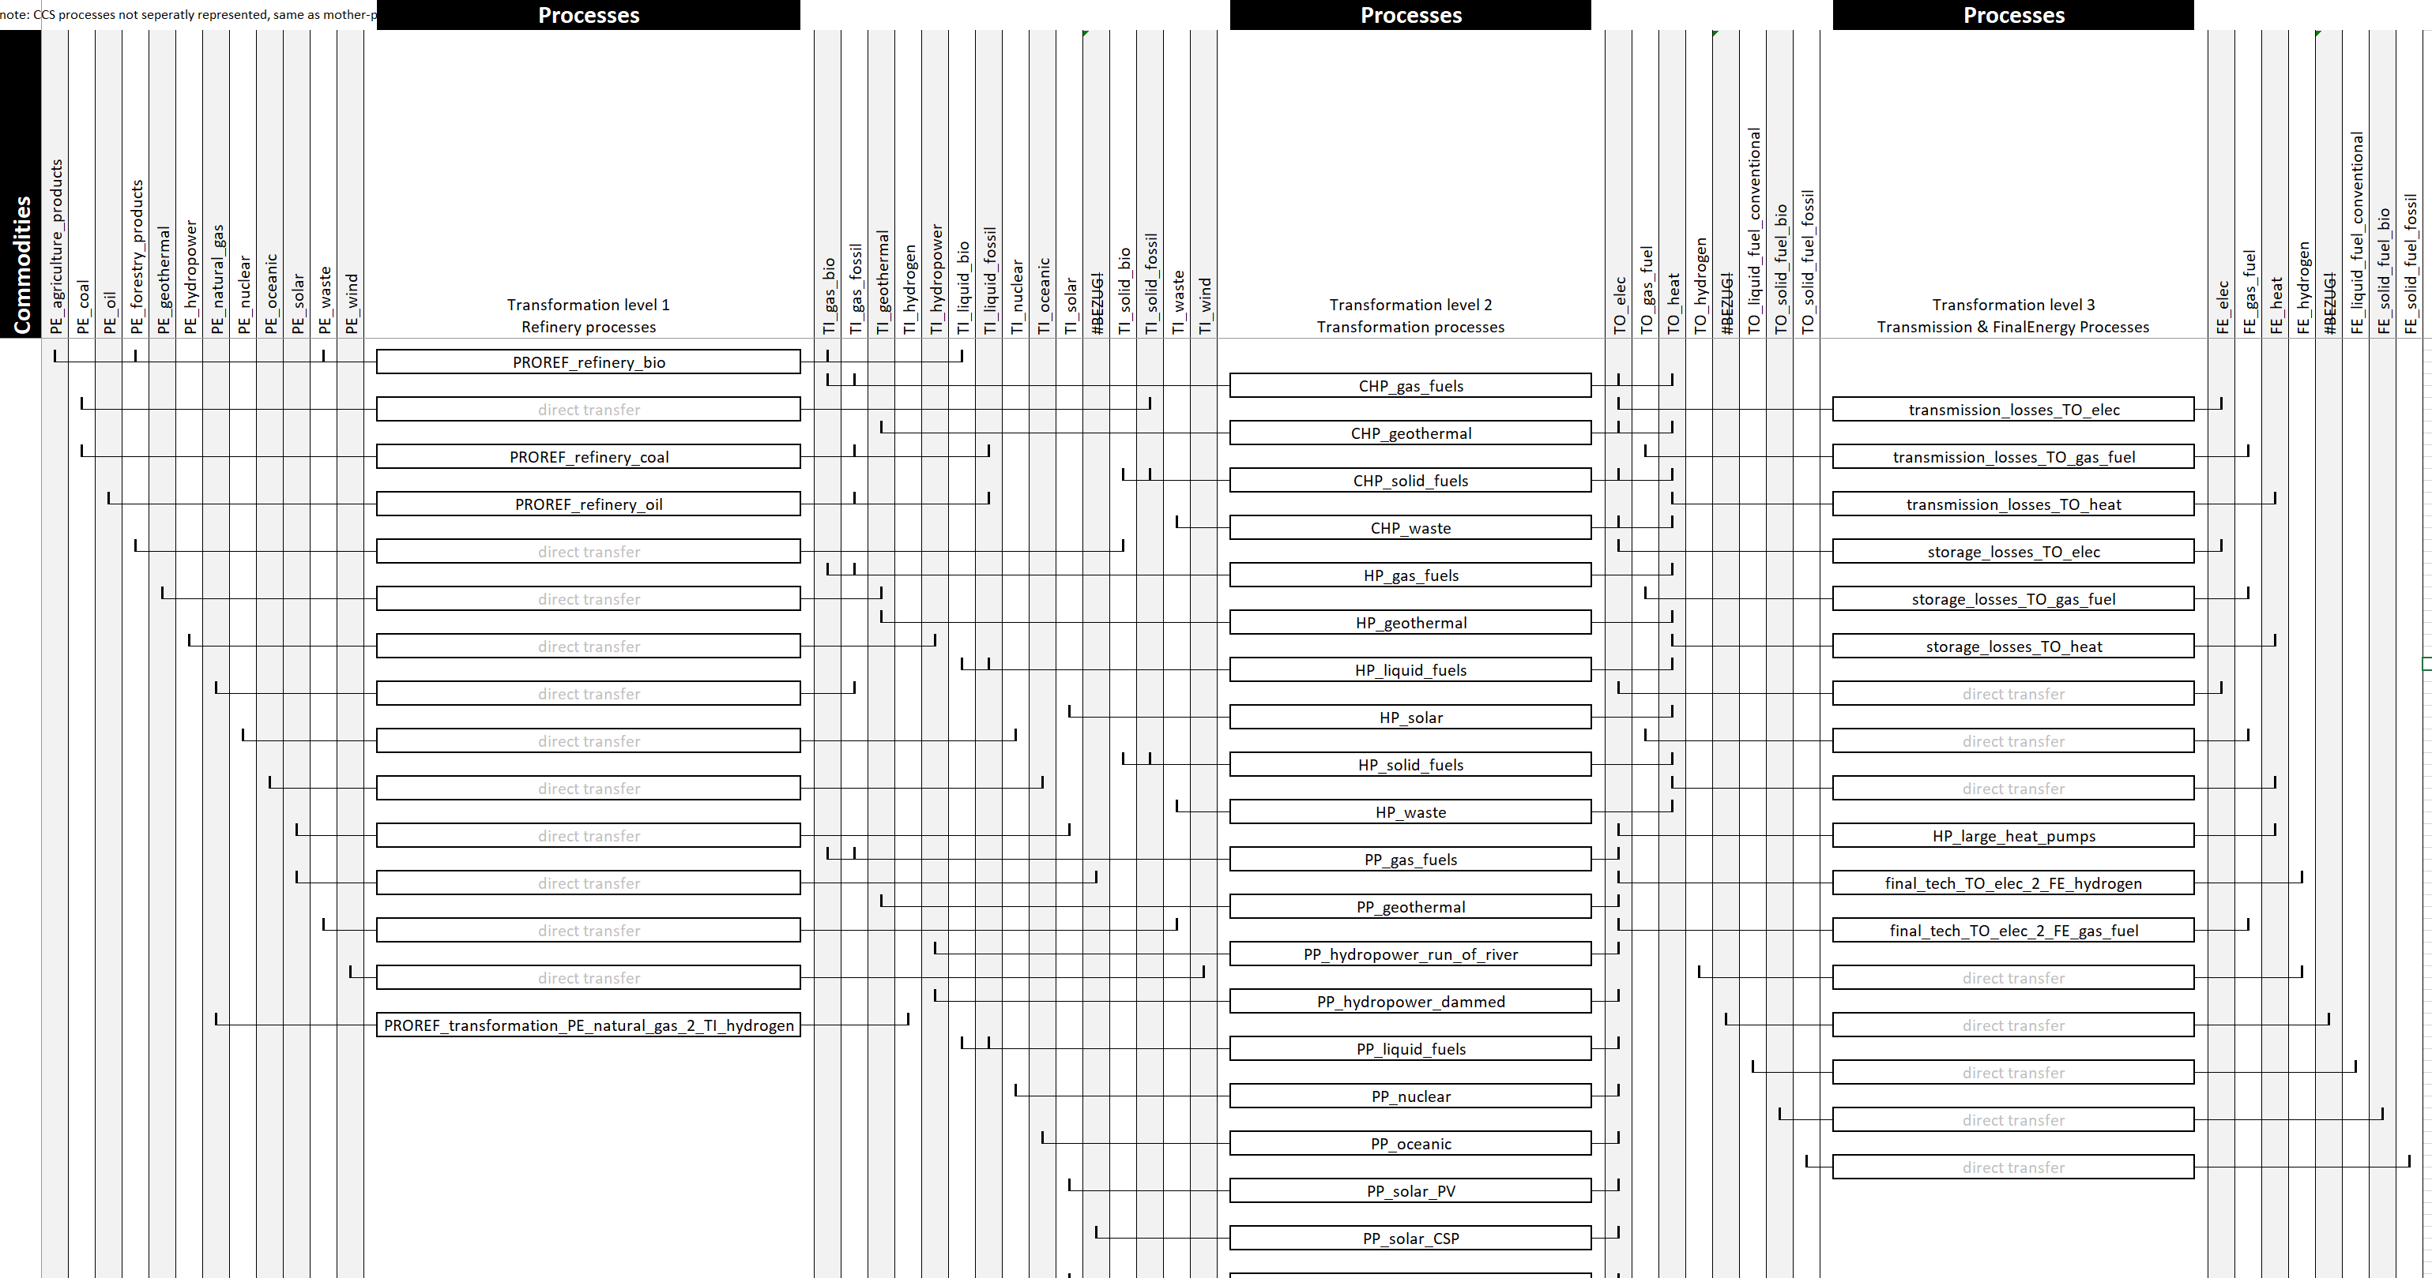
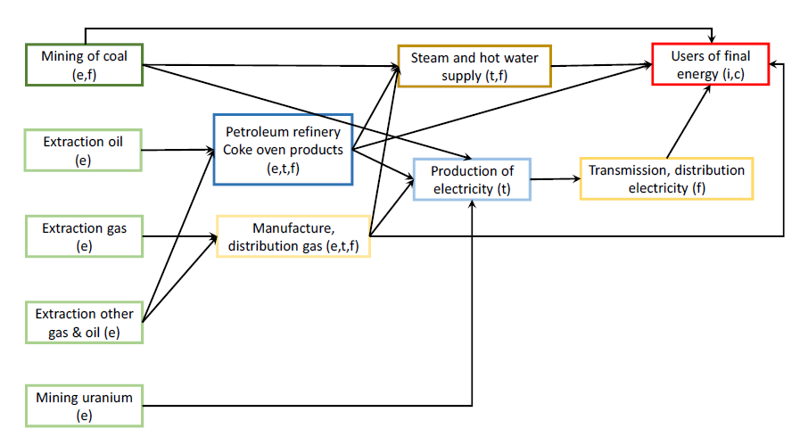
General methodology ECO-NRG
TI_gas_fossil
TI_gas_fossil
FE_gas
Linking NRG-ECO:
energy flows <-> Econ. Ouput
capacities <-> Investments (capital)
PE_natural_gas
TI_gas_bio
blending
Crops, forestry, waste (?)
TI_gas_bio
Model linking is not so straight forward, and will require a face-to-face session
Some industries do not primarily sell energy → limited Resolution
Some FE Commodities are missing (Solid Bio, Hydrogen)

Slide 49
Capacities ←→investment cost
discussion
Capacity expansion:
currently based on exogenous priorities
Could also process endogeneous signals in form of a „weighted priority“
„investement price index“ for transformation industries is available
Endogenous to the model (but subject to aggregation-issues, labor productivity etc. still exogenous)
CO2 price
Not available endogenously
Process both (CO2 price and investment cost) to calculate LCoE
EROI?
What is required to include LCoE into allocation priorities?
Correspondence matrix of Transformation Technologies to Transformation sectors
Calibration of indices with real investment cost in base year
Data research
Discussion: leave it exogeneous right now , and explore further if we have time

Slide 50
Endogenize “technology utilization allocation”
0
demand
Candidates for Endogenization:
Exogeneous priorities, e.g. „priority to RES“ policy (implemented)
Endogenous fuel-price signals
Endogeneous CO2 price signal
???
Discussion:
„Price Index by Industry“
Calibration with base-year OPEX
Required: OPEX by PROTRA for 2015
Conclusion: we go for it
Priority factor [dmnl] (0-1)
PP oil (var)
CHP gas (var)
PP gas (var)
PP gas (min)
PP oil (min)
CHP biomass (var)
CHP gas (min)
CHP waste (max)
CHP biomass (min)
Hydro power (max)
Wind power (max)
PV (max)
1
0
Annual production volumes [TJ/a]
X TJ/a

Slide 51
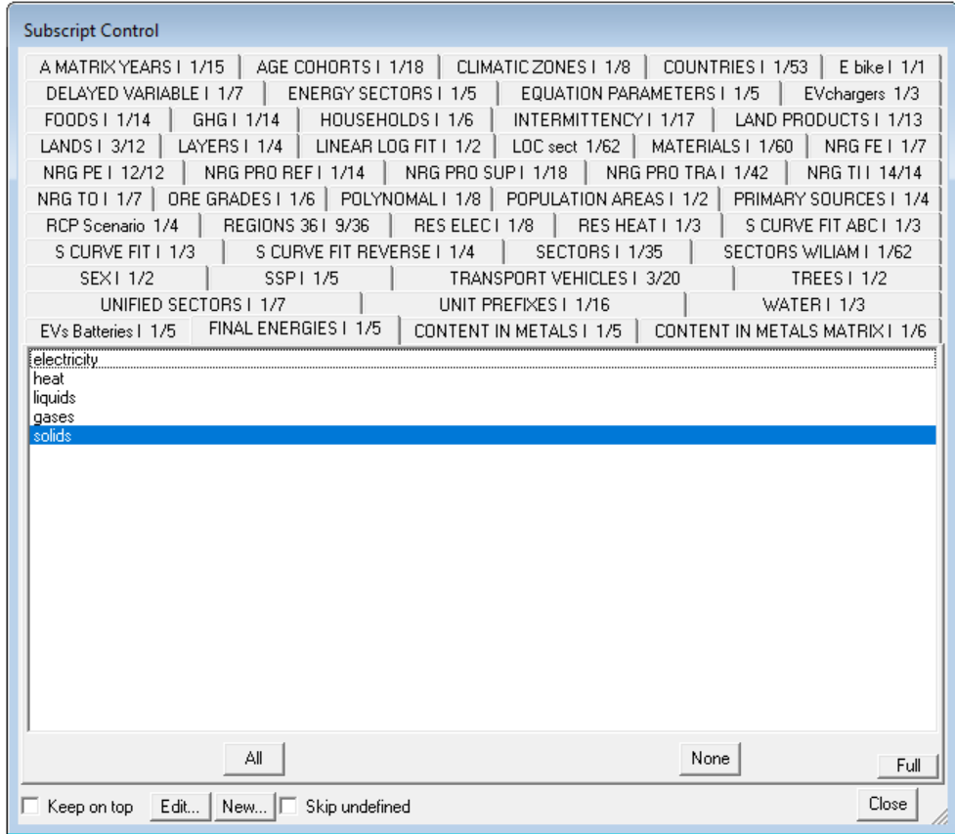
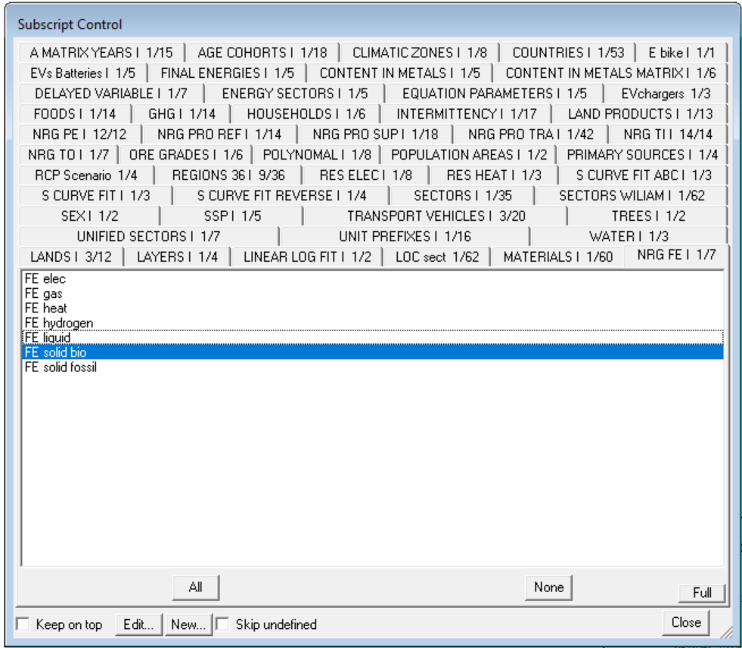
Different FE Disaggregation
FE Disaggregation ECO-module
FE Disaggregation NRG-Module
H2 fuels
Solid fossil/bio split

Slide 52
FE_solid_bio / FE_solid_fossil split
MEDEAS / ECO moduel only know „final energy solid“ demand However, it‘s important to distinguishe here between fossil (coal) and organic (wood) origin, because it constitutes a major fraction of the PE_forestry_products
We have to think of a methodology to split demand (can we get it from Household-Building-end-use submodule?)
Discussion:
Explore data in Exio-base, see if we can extrct relevant information for splitting up the FE demand from there
Theoretically could be
(a) modelled by bottom-up modelling of industry sectors (e.g. paper and pulp) or
(b) include it into energy intensities (optimal solution)
Minor issue: consistency with biomass flows between monetary and phsical flows (acceptable =)
Desicion: implement opiton b

Slide 53
Scarcity Feedback (Energy → Materials → Economy → Energy)
Economy
(MRIO-Framework)
Other Modules (indirectly involved, but not in focus)
Demography
Supply @ Price p
Materials
FE-Demand @Price p
Iterative loop until supply matches demand
Land Use & Water
Society
PE Demand
Climate
Energy
Notes:
Economy:
- MRIO Framework – depicts economic sectors with all intermediate relations.
- Sectoral disaggregation specially chosen (higher resolution in energy and mining)
Energy:
PE demand resulting from given PE demand
Materials required for energy infrastructure
Materials:
Models world resource stocks and flows
Material extraction and recycling depend on global ressources
Output: Price p($) at which quantity q(ton) can be supplied
Economy:
- MRIO: Economic demand at given price levels
- If demand > supply (production capacity): price increase → smaller FE demand → …

Slide 54
OLD STUFF
…from here onwards…

Slide 55
Energy Module
FE Imports/Exports
Emissions
Domestic PE demand
Energy End-Use
„converting USD to kWh“
Dynamic OPEX
RES Potential
„accounting for land competition“
Biophysical Limitations
Energy Transformation
„modelling annual energy balances“
Economic Demand
H2 demand
Max. Biofuel Production
Industry (top-down)
HH-Buildings (Bottom-Up)
Transport (Bottom-Up)
Max. RES Capacity by Region
FE demand
Energy transformation
chain
Energy Capacity
„accounting for capacity stocks“
Material- & Land Use
technology utilization
allocation
Available transformation Capacity
Transformation capacity – Stock- and flow modelling
vRES production with curtailment
Storage Losses
Flexible Production Tech. Utilization
Fossil PP utilization?!
Investments
Max. vRES production without curtailment
Transformation Technology Expansion allocation
DSM
Smart Charging
V2G
small heatpumps
…
Energy Variability Management
„impact of intermittent power sources
on annual energy balances“
EROI/ESOI
Estimate the Energy Return on Energy Invested of the System
Policy
Assumptions
Date: 2.2.22
Energy Module – simplified representation of most important interrelations; Source: AEA

Slide 56
Energy Module
Relation to Economy
Non-Energetic uses of PE-Fuels
FE_Trade
Linking physical and monetary demand
H2_sector
FE_solid_bio / fossil split
$ Investments in NRG-Infrastructure
Feedbacks to nrg-tech-utiliztaion-allocation (price signals)
Feedbacks to capacity-expansion-allocation (if any)
End-Use Submodule (Nacho/UVa)
Some structure from MEDEAS (non-vectorized) exists
But implementation depends on ECO-module to be implemented
New HH-energy demand sub-submodule from scratch
Related: H2-fuel Demand from Transport
Transformation Sub-Module (lukas/AEA)
Structure Implemented,
Parametrization only for EU27 completed, other Regions pending!
Capacity Sub-Module (lukas/AEA)
Structure Implemented,
Parametrization only for EU27 completed, other Regions pending!
Intermittency Submodule (Gonzalo/UVa, SDEWES)
Wind/PV Curtailment: Conceptually clear and partly implementd
Storage modelling, Flexibility modelling, internal Links to End-Use and Transformation Module: Ongoing conceptualization, not modelled
RES-Potential Submodule (Inigo/UVA, Alexandros/CRES)
GIS Analysis done, conceptualization clear, implementation pending
EROI/ESOI (UVa)
Existing code from MEDEAS – pending to be linked to WILIAM
Relation to Land / Water
Land use of solar enegy
Limits to the demand of bioenergy (wood and biofuels) and allocation of land products to energy/food/industry uses
Relation to Climate
Emissions from Energy
Relation to society
None direct (?)

Slide 57
Modelling Tasks at hand
Ongoing Modelling Tasks:
BIG: implement electrolyser capacities, storage capacities, P2H-capacities as basis for Flex-tech utilization
BIG: implement RES potentials
MEDIUM: Link EROI/ESOI Module
SMALL: Improve tech-utilization-allocation (acc. To Gonzalos suggestion)
SMALL: Link existing intermittency-parts
FORMAL: Re-organising the input excel
FORMAL: Nomenclature, Units
FORMAL: Deleting old unused MEDEAS equations
Tasks in Preparation:
BIG: parametrization of Transformation/capacity module for other regions
BIG: Implement end-use submodule
Future work:
BIG: Extent to 36 Regions

Slide 58
Energy Module
GHG Emissions
FE Imports/Exports
PE demand
Energy End-Use
„converting USD to kWh“
Fuel Prices
RES Potential
„accounting for land competition“
Biophysical Limitations
Energy Transformation
„modelling annual energy balances“
Economic Demand
Industry (top-down)
HH-Buildings (Bottom-Up)
Transport (Bottom-Up)
Final Consumption
Energy transformation
chain
Available transformation Capacity
Energy Capacity
„accounting for capacity stocks“
Investments
technology utilization
allocation
Transformation technology capacities
Curtailment, flexibility technology utilization
Material- & Land Use
Transformation Technology Expansion allocation
Power system setup
DSM, smart charging
Variability Management
„impact of intermittent power sources
on annual energy balances“
EROI/ESOI
„Estimate the Energy Return on Energy Invested of the System“
electrolyser & storage capacities
Policy
Assumptions
emulation
Date: 21.6.2022 WITH ANIMATION
Energy Module – simplified representation of most important interrelations; Source: AEA
Notes:
We saw overview before – this is what the energy module does.
END USE
Recives $ demand (by economic sector)
Convert to kWh demand (by FE-Fuel)
Mixed bottom-up top down
Bottom up: Transport, HH-buildings
Top down: industry (energy intensities)
Further work: selected industries also bottom-up
TRANSOFRMATION
Center-piece of energy module– calculates PE demand arising from FE demand.
Represents the whole energytransformation chain, and allocates the transformation technology usage („merit order“)
While accounting for all relevent influences
Capacity stock, energy variability & flexibility, etc.
CAPACITY
Accounting for stock and flow of transformation capacities
Taking into account biophysical limitations
Important hook-in point for policies
VARIABILITY
Accounts for impact of vRES on annual energy balances
Reaching 100% RES is NOT easy – it is very very hard
Requires significatn investment in flexibility technologies and overcapacities
And it‘s an effect often overlooked by annual IAMs
Methodological approach: emulating dispatch model results
100.000ds of dispatch model (EnergyPLAN) runs with different power system setups are analysed,
the resulting sub-annual timescale effects on annual energy balances emulated in WILIAM via regression analysis of results
EROI
Accounts for material and energy requirements of energy infrastructure

Slide 59
Energy Module - overview
GHG Emissions
FE Imports/Exports
PE demand
Energy End-Use
„converting USD to kWh“
Fuel Prices
RES Potential
„accounting for land competition“
Biophysical Limitations
Energy Transformation
„modelling annual energy balances“
Economic Demand
Industry (top-down)
HH-Buildings (Bottom-Up)
Transport (Bottom-Up)
Final Consumption
Energy transformation
chain
Available transformation Capacity
Energy Capacity
„accounting for capacity stocks“
Investments
technology utilization
allocation
Transformation technology capacities
Curtailment, flexibility technology utilization
Material- & Land Use
Transformation Technology Expansion allocation
Power system setup
DSM, smart charging
Variability Management
„impact of intermittent power sources
on annual energy balances“
EROI/ESOI
„Estimate the Energy Return on Energy Invested of the System“
electrolyser & storage capacities
Policy
Assumptions
emulation
Date: 21.6.2022
Energy Module – simplified representation of most important interrelations; Source: AEA
Notes:
We saw overview before – this is what the energy module does.
END USE
Recives $ demand (by economic sector)
Convert to kWh demand (by FE-Fuel)
Mixed bottom-up top down
Bottom up: Transport, HH-buildings
Top down: industry (energy intensities)
Further work: selected industries also bottom-up
TRANSOFRMATION
Center-piece of energy module– calculates PE demand arising from FE demand.
Represents the whole energytransformation chain, and allocates the transformation technology usage („merit order“)
While accounting for all relevent influences
Capacity stock, energy variability & flexibility, etc.
CAPACITY
Accounting for stock and flow of transformation capacities
Taking into account biophysical limitations
Important hook-in point for policies
VARIABILITY
Accounts for impact of vRES on annual energy balances
Reaching 100% RES is NOT easy – it is very very hard
Requires significatn investment in flexibility technologies and overcapacities
And it‘s an effect often overlooked by annual IAMs
Methodological approach: emulating dispatch model results
100.000ds of dispatch model (EnergyPLAN) runs with different power system setups are analysed,
the resulting sub-annual timescale effects on annual energy balances emulated in WILIAM via regression analysis of results
EROI
Accounts for material and energy requirements of energy infrastructure

Slide 60
GHG Emissions
Energy Module - detailed
GHG Emissions
„What does this mean for our climate?“
FE Imports/Exports
Dynamic OPEX
PE demand
Energy End-Use
„converting USD to kWh“
RES Potential
„accounting for land competition“
Biophysical Limitations
Economic Demand
Energy Transformation
„modelling annual energy balances“
Max. Biofuel Production
Industry (top-down)
HH-Buildings (Bottom-Up)
Transport (Bottom-Up)
Final consumtion
Max. RES Capacity by Region
Energy transformation
chain
Available transformation Capacity
Energy Capacity
„accounting for capacity stocks“
Material- & Land Use
technology utilization
allocation
Transformation technology capacities
Investments
FE Demand
vRES curtailment
Storage Losses
Flexibility Tech. Utilization
Transformation Technology Expansion allocation
Heating systems (DSM)
Electr. Vehicles (Smart Charging, V2G)
Generation Capacities
Variability Management
„impact of intermittent power sources
on annual energy balances“
EROI/ESOI
Estimate the Energy Return on Energy Invested of the System
electrolyser & storage capacities
Policy
Assumptions
emulation
Date: 7.6.22
Energy Module – simplified representation of most important interrelations; Source: AEA

Slide 61
Material Demand
Mineral demand of whole economy
ECO
MAT
Mineral and PE suppl at raw material price P
Potential Inconsistency:
Material demand ECO <> Material demand NRG
(for energy sectors)
FE demand of whole economy
Iterative loop until supply matches demand
PE Demand of whole economy
Material demand for energy infrastructure calculated from material intensities (Energy-sectors only)
NRG
Option a:
Only linking metals that have a directly corresponding sector
+ consistency
- Materials missing due to resoltuion of sectors

Slide 62
Material Demand
Material and PE demand of whole economy except energy sectors at price P
ECO
MAT
Iterative loop until supply matches demand
Material supply at price P
Potential Inconsistency:
Material demand ECO <> Material demand NRG
(for energy sectors)
FE demand of whole economy
Iterative loop until supply matches demand
PE Demand of whole economy
Material demand for energy infrastructure calculated from material intensities (Energy-sectors only)
Option b:
+ More accuracy and resolution of material demand for energy sectors
NRG
? How could a scarcity mechanism work (other than teh economic price-feedback loop)?

Slide 63
Hydrogen: Concept note
Not discussed
H2 is modelled as H2-Fuel (with avg. Conversion efficiencies because of the wide variety of h2 pathways)
H2 supply can come from steam reforming (exogeneous share producing PE_gas demand) or electrolyser (creating TO_elec demand)
Utilization of electrolysers to fulfill H2-demand is to be modelled variability-Sub Module (based on capacities, policy assumptions, power system setup…)
A H2-sector can be introduced to the list of economic sectors
Starting from Output=0
Structure from other sector (chemical?)

Slide 64
Biophysical limitation PE_forestry_products and PE_agriculture_products
Solid biomass available for energy production is important input to allocation
But it is subject to land use allocation, climatic zones, land productivity, CC-impact… (?)
Not discussed

Slide 65
Hydrogen fuels
Hydrogen production is implemented (both steam reforming and also Power2Hydrogen
Hydrogen demand is missing so far
Part of it coming from Transport (?)
Iron-and-Steel sector is potential big demander in future scenarios → but probably no ressources for bottom-up implementation of this sector end-use
No fitting economic sector in the current sector list (?)
Other ways to introduce H2 Demand? Exogeneous? Ideas?
Not discussed

Slide 66
Emissions from Energy transformation
Required primary energy
Available primary energy
Fuel / CO2 Prices
End-Use sub-module
2.a Transformation sub-module
2.b Transformation Capacity sub-module
Investments USD
Material demand for energy infrastructure
Transport Household
FE_demand
Energy transformation chain
(energy balancing)
Cap_required
Transformation capacity – Stock- and flow modelling
Economic Demand (USD)
Transport Freight
Transformation technology utilization allocation
Households: Buildings
Cap_available
Transformation Technology Expansion allocation
Policy Assumptions
Final Energy Intensities
(Rest of Sectors)
Available Biomass
Capacity expansion policy
Max. Transformation Ouput required [Total, Wind, PV]
Aggregated Storage Losses % [elec, gas, heat]
Sector coupling: FE_heat produced from flex. Techs (large HP and P2H)
Realizable Capacity Factor [Wind, PV]
Transformation Capacity Stock (vRES, flexible generators)
Endogeneous restrictions to capacity expansion
Later Versions of WILIAM: Sectors with significant future H2 demand (e.g. Iron & Steel)
Cap. Expansion Prioritization (?)
5. Dynamic Potential of RES
DSM – Degree of Implementation (V2G, small heatpumps, smart charging, other DSM)
3. Intermittency and Storage Sub-Module
Endogeneous restrictions (e.g. land competition)
Estimation of storage losses
capacity – storage and Flexibility technologies
4. EROI/ESOI
Calculation of EROI / ESOI figures
Note: Energy scarcity is now handeled in economic module via increase of prices
Policies (e.g. storage, grid expansion…)
Investments USD
Material demand for flex. technologies
Energy demand for capacity expansion
Version: 18.8.2021

Slide 67
*Emissions from Energy transformation
*PE_required (Crude Oil, Natural gas, Coal)
*Available_Primary_fuels [PE_I, R]
*Variable unit cost [TI_I, R] (maybe including CO2-cost?)
1. Enduse SM (UVa)
modelling of FE-demand from EI and other variables (pkm)
Allocation of scarcities (FE_consumed < FE_required)
Fuel substitution
2.a Transformation SM (AEA)
Takes Required Final energy quantitiy
Runs it through the transformation chain and back (Energy flows from Final Energy → Transformation Output → Transformation Input → Primary Energy)
Includes Technology Utilization Allocation
Includes Available fossil fuel Allocation
Energy transformation based on exisitng capacity stock (power plants)
Considering storage losses
Considering curtailment of vRES
Returns FE_consumed [by commodity and region]
2.b Transformation Capacity SM (AEA)
Modelling of transformaiton Capacity stock and the stock expansion/decommsioning in t+1
Allocation of WHICH stock is build
Cost, CO2, EROI, maybe input from intermittency (not sure if they can deliver this, though…)
*Investments$ [sector, R]
*Material demand [material,R]
FE_required [FE_I,R, S]
→ Losses in energy sector → own calculations to avoid double counting!
Cap_required
*Economic Demand
*Energy intensities
*Policies (DSM technologies, efficiency, end use technologies)
Transport HH: (UVa/WP4)
Input: pkm
Output: FE_required
*Capacity expansion policy
*restrictions capital avaiilability(?)
Transport Freight: (UVa/WP4)
Input: tkm
Output: FE_required
FE_consumed [FE_I,R, S]
Cap_available
Households: Buildings (SDEWES/WP4/Tomislav)
Input: m²/pp, kWh/m²…
Output: FE_required
*Material demand (kg/kW)
*Fulfillable Useful Energy service
* Scarcity signal
* Cf [Wind, PV, Gas by R]
* Storage Losses [elec, gas, heat, by R]
* FE_heat produced from large HP and P2H
capacities
Sectors with significant future H2 demand (e.g. Iron & Steel) (WP7):
Input: Policies
Output: FE_required
*TO_required [Total, Wind, PV, Dammed_Hydro by R]
Priorization for cap. Expansion (?)
*FE_required e-mob
*Implementation degree DSM e-mob (smart-charging AND V2G)
*Implementation degree DSM Households
*small heat pumps
*h of excess elec (?)
3. Intermittency and Storage SM (SDEWES/UVa)
Capacity stock (and expansion?) of 3 flex. Options
DSM, Vehicle2Grid, Storage
Cf = f(3 flex. options)
StorageLosses = f (3 flex. options)
4. EROI (UVa)
5. Dynamic Potential of RES (CARTIF)
*restrictions (e.g. land competition)
Final Energy Intensities
(Rest of Sectors) (Uva/WP7):
Input:
Output:
Transform. Capacity Expansion
6. Material requirements of energy technologies (Materials-Module, UoI/INN)
Version: LEG, 6.5.2021 → 21.6.
*Policies (e.g. storage, grid expansion…)
*Material energy intensities (kWh/kg)

Slide 68
Emissions from Energy transformation
Required primary energy
Available primary energy
Fuel / CO2 Prices
End-Use sub-module
2.a Transformation sub-module
2.b Transformation Capacity sub-module
Investments USD
Material demand for energy infrastructure
Transport Household
FE_required
Energy transformation chain
(energy balancing)
Cap_required
Transformation capacity – Stock- and flow modelling
Economic Demand (USD)
Transport Freight
Transformation technology utilization allocation
Households: Buildings
FE_consumed
Cap_available
Transformation Technology Expansion allocation
Policy Assumptions
Final Energy Intensities
(Rest of Sectors)
Capacity expansion policy
Transformation Ouput required [Total, Wind, PV]
Sector coupling: FE_heat produced from flex. Techs (large HP and P2H)
Available Biomass
Realizable Capacity Factor [Wind, PV]
Aggregated Storage Losses [elec, gas, heat]
FE_consumed
Endogeneous restrictions to capacity expansion
Later Versions of WILIAM: Sectors with significant future H2 demand (e.g. Iron & Steel)
5. Dynamic Potential of RES
DSM – Degree of Implementation (V2G, small heatpumps, smart charging, other DSM)
3. Intermittency and Storage Sub-Module
Endogeneous restrictions (e.g. land competition)
Estimation of storage losses
capacity – storage and Flexibility technologies
4. EROI/ESOI
Calculation of EROI / ESOI figures
Policies (e.g. storage, grid expansion…)
Investments USD
Material demand for flex. technologies
Energy demand for capacity expansion
Simplified Version D7.4: 17.5.2021

Slide 69
*Emissions from Energy transformation
*PE_required (Crude Oil, Natural gas, Coal)
*Available_Primary_fuels [PE_I, R]
*Variable unit cost [TI_I, R] (maybe including CO2-cost?)
1. Enduse SM (UVa)
modelling of FE-demand from EI and other variables (pkm)
Allocation of scarcities (FE_consumed < FE_required)
Fuel substitution
2.a Transformation SM (AEA)
Takes Required Final energy quantitiy
Runs it through the transformation chain and back (Energy flows from Final Energy → Transformation Output → Transformation Input → Primary Energy)
Includes Technology Utilization Allocation
Includes Available fossil fuel Allocation
Energy transformation based on exisitng capacity stock (power plants)
Considering storage losses
Considering curtailment of vRES
Returns FE_consumed [by commodity and region]
2.b Transformation Capacity SM (AEA)
Modelling of transformaiton Capacity stock and the stock expansion/decommsioning in t+1
Allocation of WHICH stock is build
*Investments$ [sector, R]
*Material demand [material,R]
FE_required [FE_I,R, S]
→ Losses in energy sector → own calculations to avoid double counting!
Cap_required
*Economic Demand
*Energy intensities
*Policies (DSM technologies, efficiency, end use technologies)
Transport HH: (UVa/WP4)
Input: pkm
Output: FE_required
*Capacity expansion policy
*restrictions capital avaiilability(?)
Transport Freight: (UVa/WP4)
Input: tkm
Output: FE_required
FE_consumed [FE_I,R, S]
Cap_available
Households: Buildings (SDEWES/WP4/Tomislav)
Input: m²/pp, kWh/m²…
Output: FE_required
*Material demand (kg/kW)
*Fulfillable Useful Energy service
* Scarcity signal
* Cf [Wind, PV, Gas by R]
* Storage Losses [elec, gas, heat, by R]
* FE_heat produced from large HP and P2H
*TO_required [Total, Wind, PV, Dammed_Hydro by R]
h of excess elec (?)
Sectors with significant future H2 demand (e.g. Iron & Steel) (WP7):
Input: Policies
Output: FE_required
*FE_required e-mob
*Implementation degree DSM e-mob (smart-charging AND V2G)
*Implementation degree DSM Households
*small heat pumps
*h of excess elec (?)
3. Intermittency and Storage SM (SDEWES/UVa)
Capacity stock (and expansion?) of 3 flex. Options
DSM, Vehicle2Grid, Storage
Cf = f(3 flex. options)
StorageLosses = f (3 flex. options)
4. EROI (UVa)
5. Dynamic Potential of RES (CARTIF)
*restrictions (e.g. land competition)
Final Energy Intensities
(Rest of Sectors) (Uva/WP7):
Input:
Output:
Transform. Capacity Expansion
6. Material requirements of energy technologies (Materials-Module, UoI/INN)
Version: LEG, 6.5.2021
*Policies (e.g. storage, grid expansion…)
*Material energy intensities (kWh/kg)

Slide 70
*Emissions from Energy transformation
*PE_required (Crude Oil, Natural gas, Coal)
*Available_Primary_fuels [PE_I, R]
*Variable unit cost [TI_I, R] (maybe including CO2-cost?)
1. Enduse SM (UVa)
modelling of FE-demand from EI and other variables (pkm)
Allocation of scarcities (FE_consumed < FE_required)
Fuel substitution
2.a Transformation SM (AEA)
Takes Required Final energy quantitiy
Runs it through the transformation chain and back (Energy flows from Final Energy → Transformation Output → Transformation Input → Primary Energy)
Includes Technology Utilization Allocation
Includes Available fossil fuel Allocation
Energy transformation based on exisitng capacity stock (power plants)
Considering storage losses
Considering curtailment of vRES
Returns FE_consumed [by commodity and region]
2.b Transformation Capacity SM (AEA)
Modelling of transformaiton Capacity stock and the stock expansion/decommsioning in t+1
Allocation of WHICH stock is build
*Investments$ [sector, R]
*Material demand [material,R]
FE_required [FE_I,R, S]
→ Losses in energy sector → own calculations to avoid double counting!
Cap_required
*Economic Demand
*Energy intensities
*Policies (DSM technologies, efficiency, end use technologies)
Transport HH: (UVa/WP4)
Input: pkm
Output: FE_required
*Capacity expansion policy
*restrictions capital avaiilability(?)
Transport Freight: (UVa/WP4)
Input: tkm
Output: FE_required
FE_consumed [FE_I,R, S]
Cap_available
Households: Buildings (SDEWES/WP4/Tomislav)
Input: m²/pp, kWh/m²…
Output: FE_required
*Material demand (kg/kW)
*Fulfillable Useful Energy service
* Scarcity signal
* Cf [Wind, PV, Gas by R]
* Storage Losses [elec, gas, heat, by R]
* FE_heat produced from large HP and P2H
*TO_required [Total, Wind, PV, Dammed_Hydro by R]
h of excess elec (?)
Sectors with significant future H2 demand (e.g. Iron & Steel) (WP7):
Input: Policies
Output: FE_required
Transform. Capacity Expansion
*FE_required e-mob
*Implementation degree DSM e-mob (smart-charging AND V2G)
*Implementation degree DSM Households
*small heat pumps
*h of excess elec (?)
3. Intermittency and Storage SM (SDEWES/UVa)
Capacity stock (and expansion?) of 3 flex. Options
DSM, Vehicle2Grid, Storage
Cf = f(3 flex. options)
StorageLosses = f (3 flex. options)
4. EROI (UVa)
5. Dynamic Potential of RES (CARTIF)
*restrictions (e.g. land competition)
Final Energy Intensities
(Rest of Sectors) (Uva/WP7):
Input:
Output:
6. Material requirements of energy technologies (UoI/INN)
*Material energy intensities (kWh/kg)
Version: LEG, 28.4.2021
*Policies (e.g. storage, grid expansion…)

